Slide 1
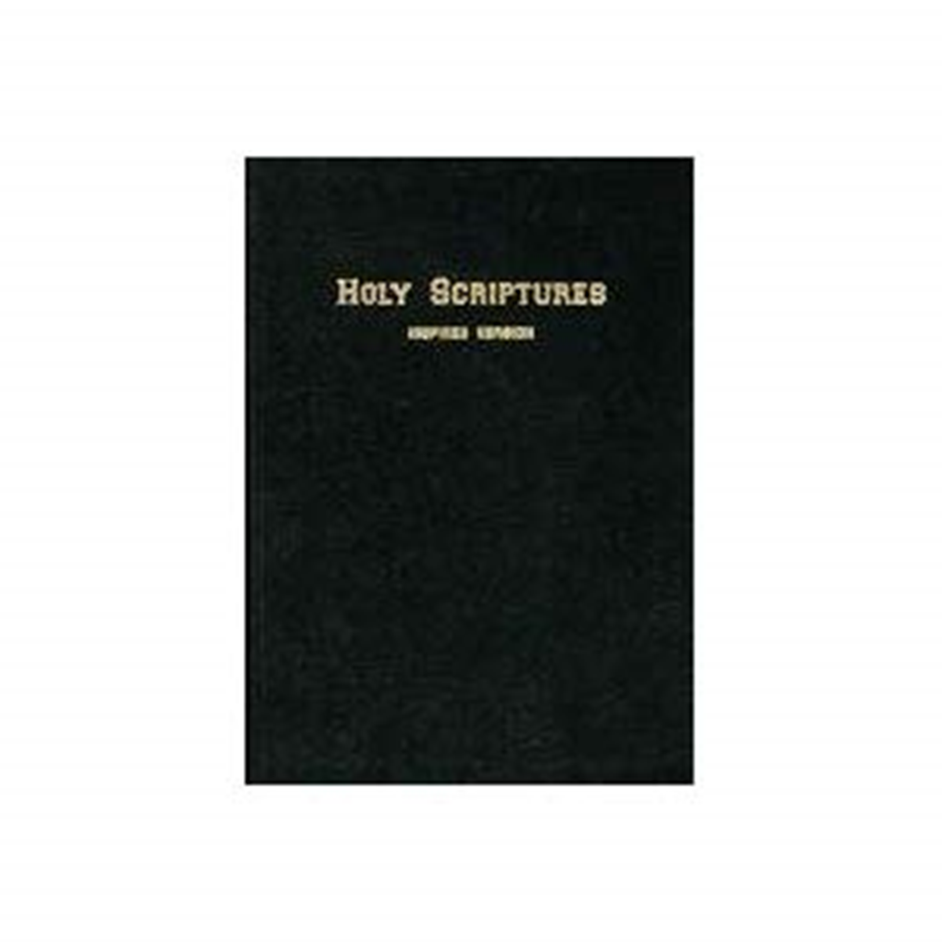
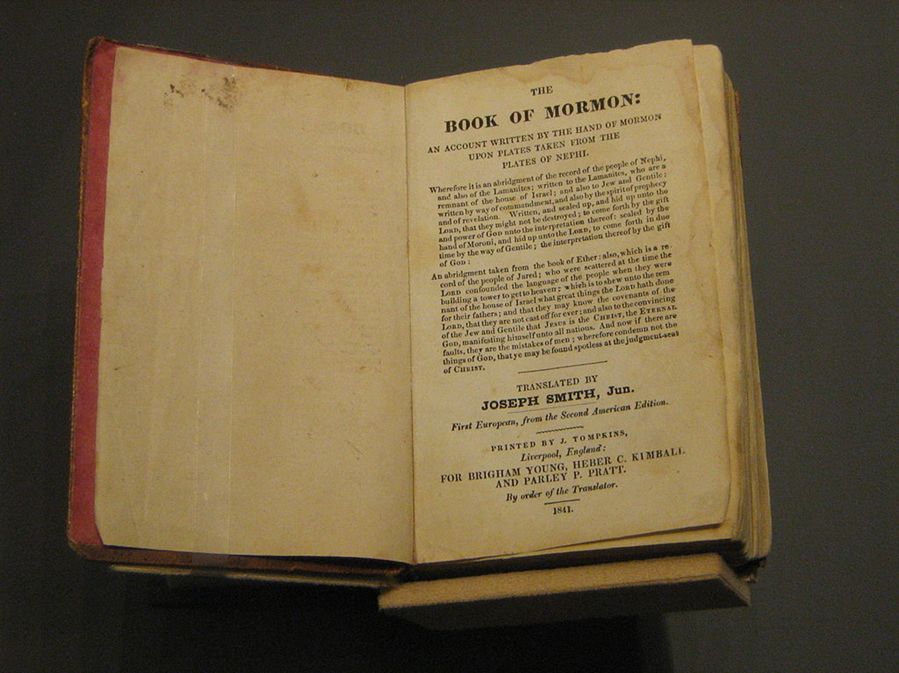
Comparing
2 Nephi 2 with Genesis 50 I.V.

Slide 2
2Ne 2:1 And now, I speak unto you, Joseph, my last born.
2 Thou wast born in the wilderness of mine afflictions; yea, in the days of my greatest sorrow did thy mother bear thee.
3 And may the Lord consecrate also unto thee this land, which is a most precious land, for thine inheritance and the inheritance of thy seed with thy brethren, for thy security forever--if it so be that ye shall keep the commandments of the Holy One of Israel.
4 And now, Joseph, my last born, whom I have brought out of the wilderness of mine afflictions, may the Lord bless thee forever, for thy seed shall not utterly be destroyed.
5 For behold, thou art the fruit of my loins; and I am a descendant of Joseph, who was carried captive into Egypt.
6 And great were the covenants of the Lord which he made unto Joseph; wherefore, Joseph truly saw our day.
7 And he obtained a promise of the Lord, that out of the fruit of his loins the Lord God would raise up a righteous branch unto the house of Israel—
8 Not the Messiah,
but a branch which was to be broken off, nevertheless, to be remembered in the covenants of the Lord,
9 That the Messiah should be made manifest unto them in the latter days, in the spirit of power, unto the bringing of them out of darkness unto light, yea, out of hidden darkness and out of captivity unto freedom.
10 For Joseph truly testified, saying, A seer shall the Lord, my God, raise up, who shall be a choice seer unto the fruit of my loins.
11 Yea, Joseph truly said, Thus saith the Lord unto me: A choice seer will I raise up out of the fruit of thy loins; and he shall be esteemed highly among the fruit of thy loins.
12 And unto him will I give commandment, that he shall do a work for the fruit of thy loins, his brethren, which shall be of great worth unto them, even to the bringing of them to the knowledge of the covenants which I have made with thy fathers.
13 And I will give unto him a commandment, that he shall do none other work save the work which I shall command him.
2Ne 2:14 And I will make him great in mine eyes, for he shall do my work.
Gen 50:24 And Joseph [of Egypt] said unto his brethren, I die and go unto my fathers; and I go down to my grave with joy. The God of my father Jacob be with you, to deliver you out of affliction in the days of your bondage; for the Lord hath visited me, and I have obtained a promise of the Lord that out of the fruit of my loins the Lord God will raise up a righteous branch out of my loins;
and unto thee [his brethren], whom my father Jacob hath named Israel, a prophet
(not the Messiah who is called Shilo);
and this prophet shall deliver my people out of Egypt in the days of thy bondage.
25 And it shall come to pass that they shall be scattered again; and a branch shall be broken off and shall be carried into a far country; nevertheless, they shall be remembered in the covenants of the Lord when the Messiah cometh; for he shall be made manifest unto them in the latter days, in the Spirit of power, and shall bring them out of darkness into light--out of hidden darkness and out of captivity unto freedom.
26 A seer shall the Lord my God raise up, who shall be a choice seer unto the fruit of my loins.
27 Thus saith the Lord God of my fathers unto me, A choice seer will I raise up out of the fruit of thy loins, and he shall be esteemed highly among the fruit of thy loins;
and unto him will I give commandment that he shall do a work for the fruit of thy loins, his brethren.
28 And he shall bring them to the knowledge of the covenants which I have made with thy fathers;
and he shall do whatsoever work I shall command him.
29 And I will make him great in mine eyes, for he shall do my work;

Slide 3
2Ne 2:1 And now, I speak unto you, Joseph, my last born.
2 Thou wast born in the wilderness of mine afflictions; yea, in the days of my greatest sorrow did thy mother bear thee.
3 And may the Lord consecrate also unto thee this land, which is a most precious land, for thine inheritance and the inheritance of thy seed with thy brethren, for thy security forever--if it so be that ye shall keep the commandments of the Holy One of Israel.
4 And now, Joseph, my last born, whom I have brought out of the wilderness of mine afflictions, may the Lord bless thee forever, for thy seed shall not utterly be destroyed.
5 For behold, thou art the fruit of my loins; and I am a descendant of Joseph, who was carried captive into Egypt.
6 And great were the covenants of the Lord which he made unto Joseph; wherefore, Joseph truly saw our day.
7 And he obtained a promise of the Lord, that out of the fruit of his loins the Lord God would raise up a righteous branch unto the house of Israel—
8 Not the Messiah,
but a branch which was to be broken off, nevertheless, to be remembered in the covenants of the Lord,
9 That the Messiah should be made manifest unto them in the latter days, in the spirit of power, unto the bringing of them out of darkness unto light, yea, out of hidden darkness and out of captivity unto freedom.
10 For Joseph truly testified, saying, A seer shall the Lord, my God, raise up, who shall be a choice seer unto the fruit of my loins.
11 Yea, Joseph truly said, Thus saith the Lord unto me: A choice seer will I raise up out of the fruit of thy loins; and he shall be esteemed highly among the fruit of thy loins.
12 And unto him will I give commandment, that he shall do a work for the fruit of thy loins, his brethren, which shall be of great worth unto them, even to the bringing of them to the knowledge of the covenants which I have made with thy fathers.
13 And I will give unto him a commandment, that he shall do none other work save the work which I shall command him.
2Ne 2:14 And I will make him great in mine eyes, for he shall do my work.
Gen 50:24 And Joseph [of Egypt] said unto his brethren, I die and go unto my fathers; and I go down to my grave with joy. The God of my father Jacob be with you, to deliver you out of affliction in the days of your bondage; for the Lord hath visited me, and I have obtained a promise of the Lord that out of the fruit of my loins the Lord God will raise up a righteous branch out of my loins;
and unto thee [his brethren], whom my father Jacob hath named Israel, a prophet
(not the Messiah who is called Shilo);
and this prophet shall deliver my people out of Egypt in the days of thy bondage.
25 And it shall come to pass that they shall be scattered again; and a branch shall be broken off and shall be carried into a far country; nevertheless, they shall be remembered in the covenants of the Lord when the Messiah cometh; for he shall be made manifest unto them in the latter days, in the Spirit of power, and shall bring them out of darkness into light--out of hidden darkness and out of captivity unto freedom.
26 A seer shall the Lord my God raise up, who shall be a choice seer unto the fruit of my loins.
27 Thus saith the Lord God of my fathers unto me, A choice seer will I raise up out of the fruit of thy loins, and he shall be esteemed highly among the fruit of thy loins;
and unto him will I give commandment that he shall do a work for the fruit of thy loins, his brethren.
28 And he shall bring them to the knowledge of the covenants which I have made with thy fathers;
and he shall do whatsoever work I shall command him.
29 And I will make him great in mine eyes, for he shall do my work;
Moses

Slide 4
2Ne 2:1 And now, I speak unto you, Joseph, my last born.
2 Thou wast born in the wilderness of mine afflictions; yea, in the days of my greatest sorrow did thy mother bear thee.
3 And may the Lord consecrate also unto thee this land, which is a most precious land, for thine inheritance and the inheritance of thy seed with thy brethren, for thy security forever--if it so be that ye shall keep the commandments of the Holy One of Israel.
4 And now, Joseph, my last born, whom I have brought out of the wilderness of mine afflictions, may the Lord bless thee forever, for thy seed shall not utterly be destroyed.
5 For behold, thou art the fruit of my loins; and I am a descendant of Joseph, who was carried captive into Egypt.
6 And great were the covenants of the Lord which he made unto Joseph; wherefore, Joseph truly saw our day.
7 And he obtained a promise of the Lord, that out of the fruit of his loins the Lord God would raise up a righteous branch unto the house of Israel—
8 Not the Messiah,
but a branch which was to be broken off, nevertheless, to be remembered in the covenants of the Lord,
9 That the Messiah should be made manifest unto them in the latter days, in the spirit of power, unto the bringing of them out of darkness unto light, yea, out of hidden darkness and out of captivity unto freedom.
10 For Joseph truly testified, saying, A seer shall the Lord, my God, raise up, who shall be a choice seer unto the fruit of my loins.
11 Yea, Joseph truly said, Thus saith the Lord unto me: A choice seer will I raise up out of the fruit of thy loins; and he shall be esteemed highly among the fruit of thy loins.
12 And unto him will I give commandment, that he shall do a work for the fruit of thy loins, his brethren, which shall be of great worth unto them, even to the bringing of them to the knowledge of the covenants which I have made with thy fathers.
13 And I will give unto him a commandment, that he shall do none other work save the work which I shall command him.
2Ne 2:14 And I will make him great in mine eyes, for he shall do my work.
Gen 50:24 And Joseph [of Egypt] said unto his brethren, I die and go unto my fathers; and I go down to my grave with joy. The God of my father Jacob be with you, to deliver you out of affliction in the days of your bondage; for the Lord hath visited me, and I have obtained a promise of the Lord that out of the fruit of my loins the Lord God will raise up a righteous branch out of my loins;
and unto thee [his brethren], whom my father Jacob hath named Israel, a prophet
(not the Messiah who is called Shilo);
and this prophet shall deliver my people out of Egypt in the days of thy bondage.
25 And it shall come to pass that they shall be scattered again; and a branch shall be broken off and shall be carried into a far country; nevertheless, they shall be remembered in the covenants of the Lord when the Messiah cometh; for he shall be made manifest unto them in the latter days, in the Spirit of power, and shall bring them out of darkness into light--out of hidden darkness and out of captivity unto freedom.
26 A seer shall the Lord my God raise up, who shall be a choice seer unto the fruit of my loins.
27 Thus saith the Lord God of my fathers unto me, A choice seer will I raise up out of the fruit of thy loins, and he shall be esteemed highly among the fruit of thy loins;
and unto him will I give commandment that he shall do a work for the fruit of thy loins, his brethren.
28 And he shall bring them to the knowledge of the covenants which I have made with thy fathers;
and he shall do whatsoever work I shall command him.
29 And I will make him great in mine eyes, for he shall do my work;
Moses
Joseph Smith Jr

Slide 5
2Ne 2:1 And now, I speak unto you, Joseph, my last born.
2 Thou wast born in the wilderness of mine afflictions; yea, in the days of my greatest sorrow did thy mother bear thee.
3 And may the Lord consecrate also unto thee this land, which is a most precious land, for thine inheritance and the inheritance of thy seed with thy brethren, for thy security forever--if it so be that ye shall keep the commandments of the Holy One of Israel.
4 And now, Joseph, my last born, whom I have brought out of the wilderness of mine afflictions, may the Lord bless thee forever, for thy seed shall not utterly be destroyed.
5 For behold, thou art the fruit of my loins; and I am a descendant of Joseph, who was carried captive into Egypt.
6 And great were the covenants of the Lord which he made unto Joseph; wherefore, Joseph truly saw our day.
7 And he obtained a promise of the Lord, that out of the fruit of his loins the Lord God would raise up a righteous branch unto the house of Israel—
8 Not the Messiah,
but a branch which was to be broken off, nevertheless, to be remembered in the covenants of the Lord,
9 That the Messiah should be made manifest unto them in the latter days, in the spirit of power, unto the bringing of them out of darkness unto light, yea, out of hidden darkness and out of captivity unto freedom.
10 For Joseph truly testified, saying, A seer shall the Lord, my God, raise up, who shall be a choice seer unto the fruit of my loins.
11 Yea, Joseph truly said, Thus saith the Lord unto me: A choice seer will I raise up out of the fruit of thy loins; and he shall be esteemed highly among the fruit of thy loins.
12 And unto him will I give commandment, that he shall do a work for the fruit of thy loins, his brethren, which shall be of great worth unto them, even to the bringing of them to the knowledge of the covenants which I have made with thy fathers.
13 And I will give unto him a commandment, that he shall do none other work save the work which I shall command him.
2Ne 2:14 And I will make him great in mine eyes, for he shall do my work.
Gen 50:24 And Joseph [of Egypt] said unto his brethren, I die and go unto my fathers; and I go down to my grave with joy. The God of my father Jacob be with you, to deliver you out of affliction in the days of your bondage; for the Lord hath visited me, and I have obtained a promise of the Lord that out of the fruit of my loins the Lord God will raise up a righteous branch out of my loins;
and unto thee [his brethren], whom my father Jacob hath named Israel, a prophet
(not the Messiah who is called Shilo);
and this prophet shall deliver my people out of Egypt in the days of thy bondage.
25 And it shall come to pass that they shall be scattered again; and a branch shall be broken off and shall be carried into a far country; nevertheless, they shall be remembered in the covenants of the Lord when the Messiah cometh; for he shall be made manifest unto them in the latter days, in the Spirit of power, and shall bring them out of darkness into light--out of hidden darkness and out of captivity unto freedom.
26 A seer shall the Lord my God raise up, who shall be a choice seer unto the fruit of my loins.
27 Thus saith the Lord God of my fathers unto me, A choice seer will I raise up out of the fruit of thy loins, and he shall be esteemed highly among the fruit of thy loins;
and unto him will I give commandment that he shall do a work for the fruit of thy loins, his brethren.
28 And he shall bring them to the knowledge of the covenants which I have made with thy fathers;
and he shall do whatsoever work I shall command him.
29 And I will make him great in mine eyes, for he shall do my work;
Moses
Joseph Smith Jr

Slide 6
and he shall be great like unto him whom I have said I would raise up unto you, to deliver my people, O house of Israel, out of the land of Egypt; for a seer will I raise up to deliver my people out of the land of Egypt; and he shall be called Moses. And by this name he shall know that he is of thy house; for he shall be nursed by the king's daughter and shall be called her son.
Gen 50:30 And again, a seer will I raise up out of the fruit of thy loins, and unto him will I give power to bring forth my word unto the seed of thy loins--and not to the bringing forth of my word only, saith the Lord, but to the convincing them of my word, which shall have already gone forth among them in the last days;
31 Wherefore, the fruit of thy loins shall write, and the fruit of the loins of Judah shall write;
and that which shall be written by the fruit of thy loins and also that which shall be written by the fruit of the loins of Judah shall grow together
unto the confounding of false doctrines, and laying down of contentions, and establishing peace among the fruit of thy loins,
and bringing them to a knowledge of their fathers in the latter days,
and also to the knowledge of my covenants, saith the Lord.
2Ne 2:15 And he shall be great like unto Moses, whom I have said I would raise up unto you to deliver my people, O house of Israel.
16 And Moses will I raise up to deliver thy people out of the land of Egypt.
17 But a seer will I raise up out of the fruit of thy loins; and unto him will I give power to bring forth my word unto the seed of thy loins--
18 And not to the bringing forth my word only, saith the Lord, but to the convincing them of my word, which shall have already gone forth among them.
19 Wherefore, the fruit of thy loins shall write; and the fruit of the loins of Judah shall write;
20 And that which shall be written by the fruit of thy loins and also that which shall be written by the fruit of the loins of Judah shall grow together,
21 Unto the confounding of false doctrines, and laying down of contentions, and establishing peace among the fruit of thy loins,
22 And bringing them to the knowledge of their fathers in the latter days,
23 And also to the knowledge of my covenants, saith the Lord.

Slide 7
and he Jospeh Jr shall be great like unto him Jospeh Egypt whom I have said I would raise up unto you, to deliver my people, O house of Israel, out of the land of Egypt; for a seer will I raise up to deliver my people out of the land of Egypt; and he shall be called Moses. And by this name he shall know that he is of thy house; for he shall be nursed by the king's daughter and shall be called her son.
Gen 50:30 And again, a seer will I raise up out of the fruit of thy loins, and unto him will I give power to bring forth my word unto the seed of thy loins--and not to the bringing forth of my word only, saith the Lord, but to the convincing them of my word, which shall have already gone forth among them in the last days;
31 Wherefore, the fruit of thy loins shall write, and the fruit of the loins of Judah shall write;
and that which shall be written by the fruit of thy loins and also that which shall be written by the fruit of the loins of Judah shall grow together
unto the confounding of false doctrines, and laying down of contentions, and establishing peace among the fruit of thy loins,
and bringing them to a knowledge of their fathers in the latter days,
and also to the knowledge of my covenants, saith the Lord.
2Ne 2:15 And he shall be great like unto Moses, whom I have said I would raise up unto you to deliver my people, O house of Israel.
16 And Moses will I raise up to deliver thy people out of the land of Egypt.
17 But a seer will I raise up out of the fruit of thy loins; and unto him will I give power to bring forth my word unto the seed of thy loins--
18 And not to the bringing forth my word only, saith the Lord, but to the convincing them of my word, which shall have already gone forth among them.
19 Wherefore, the fruit of thy loins shall write; and the fruit of the loins of Judah shall write;
20 And that which shall be written by the fruit of thy loins and also that which shall be written by the fruit of the loins of Judah shall grow together,
21 Unto the confounding of false doctrines, and laying down of contentions, and establishing peace among the fruit of thy loins,
22 And bringing them to the knowledge of their fathers in the latter days,
23 And also to the knowledge of my covenants, saith the Lord.

Slide 8
and he shall be great like unto him whom I have said I would raise up unto you, to deliver my people, O house of Israel, out of the land of Egypt; for a seer will I raise up to deliver my people out of the land of Egypt; and he shall be called Moses. And by this name he shall know that he is of thy house; for he shall be nursed by the king's daughter and shall be called her son.
Gen 50:30 And again, a seer will I raise up out of the fruit of thy loins, and unto him will I give power to bring forth my word unto the seed of thy loins--and not to the bringing forth of my word only, saith the Lord, but to the convincing them of my word, which shall have already gone forth among them in the last days;
31 Wherefore, the fruit of thy loins shall write, and the fruit of the loins of Judah shall write;
and that which shall be written by the fruit of thy loins and also that which shall be written by the fruit of the loins of Judah shall grow together
unto the confounding of false doctrines, and laying down of contentions, and establishing peace among the fruit of thy loins,
and bringing them to a knowledge of their fathers in the latter days,
and also to the knowledge of my covenants, saith the Lord.
2Ne 2:15 And he shall be great like unto Moses, whom I have said I would raise up unto you to deliver my people, O house of Israel.
16 And Moses will I raise up to deliver thy people out of the land of Egypt.
17 But a seer will I raise up out of the fruit of thy loins; and unto him will I give power to bring forth my word unto the seed of thy loins--
18 And not to the bringing forth my word only, saith the Lord, but to the convincing them of my word, which shall have already gone forth among them.
19 Wherefore, the fruit of thy loins shall write; and the fruit of the loins of Judah shall write;
20 And that which shall be written by the fruit of thy loins and also that which shall be written by the fruit of the loins of Judah shall grow together,
21 Unto the confounding of false doctrines, and laying down of contentions, and establishing peace among the fruit of thy loins,
22 And bringing them to the knowledge of their fathers in the latter days,
23 And also to the knowledge of my covenants, saith the Lord.

Slide 9
and he shall be great like unto him whom I have said I would raise up unto you, to deliver my people, O house of Israel, out of the land of Egypt; for a seer will I raise up to deliver my people out of the land of Egypt; and he shall be called Moses. And by this name he shall know that he is of thy house; for he shall be nursed by the king's daughter and shall be called her son.
Gen 50:30 And again, a seer will I raise up out of the fruit of thy loins, and unto him will I give power to bring forth my word unto the seed of thy loins--and not to the bringing forth of my word only, saith the Lord, but to the convincing them of my word, which shall have already gone forth among them in the last days;
31 Wherefore, the fruit of thy loins shall write, and the fruit of the loins of Judah shall write;
and that which shall be written by the fruit of thy loins and also that which shall be written by the fruit of the loins of Judah shall grow together
unto the confounding of false doctrines, and laying down of contentions, and establishing peace among the fruit of thy loins,
and bringing them to a knowledge of their fathers in the latter days,
and also to the knowledge of my covenants, saith the Lord.
2Ne 2:15 And he shall be great like unto Moses, whom I have said I would raise up unto you to deliver my people, O house of Israel.
16 And Moses will I raise up to deliver thy people out of the land of Egypt.
17 But a seer will I raise up out of the fruit of thy loins; and unto him will I give power to bring forth my word unto the seed of thy loins--
18 And not to the bringing forth my word only, saith the Lord, but to the convincing them of my word, which shall have already gone forth among them.
19 Wherefore, the fruit of thy loins shall write; and the fruit of the loins of Judah shall write;
20 And that which shall be written by the fruit of thy loins and also that which shall be written by the fruit of the loins of Judah shall grow together,
21 Unto the confounding of false doctrines, and laying down of contentions, and establishing peace among the fruit of thy loins,
22 And bringing them to the knowledge of their fathers in the latter days,
23 And also to the knowledge of my covenants, saith the Lord.
Note the purposes of the Book of Mormon as stated by Moroni on the Title Page

Slide 10
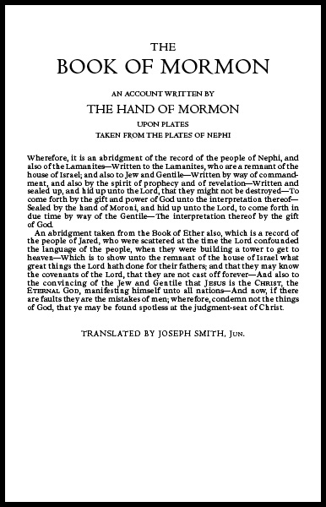

Slide 13
2 Nephi
24 And out of weakness he shall be made strong, in that day when my work shall commence among all my people, unto the restoring thee, O house of Israel, saith the Lord.
25 And thus prophesied Joseph, saying, Behold, that seer will the Lord bless;
26 And they that seek to destroy him shall be confounded;
27 For this promise, of which I have obtained of the Lord of the fruit of thy loins, shall be fulfilled.
28 Behold, I am sure of the fulfilling of this promise.
29 And his name shall be called after me;
and it shall be after the name of his father.
30 And he shall be like unto me; for the thing which the Lord shall bring forth by his hand, by the power of the Lord, shall bring my people unto salvation;
Gen 50
32 And out of weakness shall he be made strong in that day when my work shall go forth among all my people, which shall restore them who are of the house of Israel in the last days.
33 And that seer will I bless, and they that seek to destroy him shall be confounded;
for this promise I give unto you;
for I will remember you from generation to generation; and
his name shall be called Joseph,
and it shall be after the name of his father;
and he shall be like unto you; for the thing which the Lord shall bring forth by his hand shall bring my people unto salvation.

Slide 14
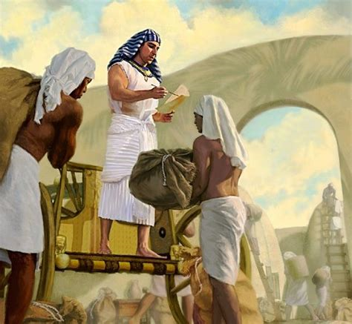
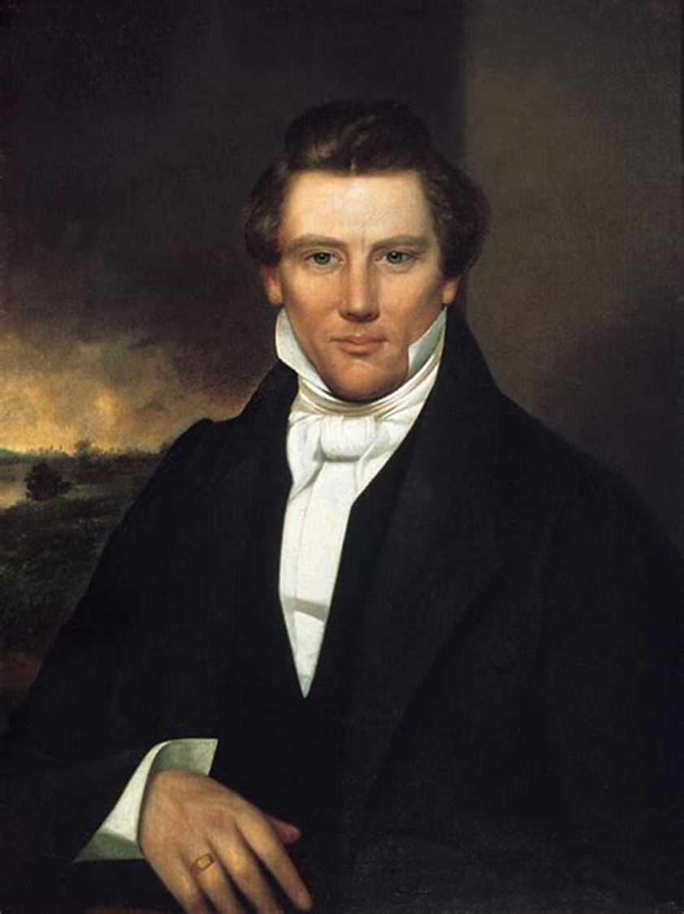
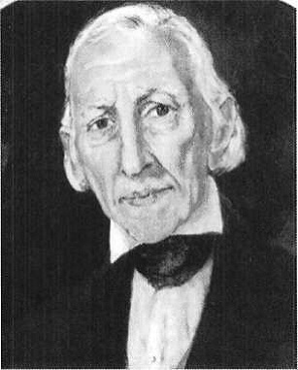
Gen 50:32 And out of weakness shall he be made strong in that day when my work shall go forth among all my people, which shall restore them who are of the house of Israel in the last days.
33 And that seer will I bless, and they that seek to destroy him shall be confounded;
for this promise I give unto you;
for I will remember you from generation to generation; and
his name shall be called Joseph, Smith, Jr
and it shall be after the name of his father;
and he shall be like unto you; for the thing which the Lord shall bring forth by his hand shall bring my people unto salvation.
2 N 2:24 And out of weakness he shall be made strong, in that day when my work shall commence among all my people, unto the restoring thee, O house of Israel, saith the Lord.
25 And thus prophesied Joseph, saying, Behold, that seer will the Lord bless;
26 And they that seek to destroy him shall be confounded;
27 For this promise, of which I have obtained of the Lord of the fruit of thy loins, shall be fulfilled.
28 Behold, I am sure of the fulfilling of this promise.
29 And his name shall be called after me; Joseph of Egypt speaking
and it shall be after the name of his father.
30 And he shall be like unto me; for the thing which the Lord shall bring forth by his hand, by the power of the Lord, shall bring my people unto salvation;

Slide 15
Gen 50:34 And the Lord sware unto Joseph that he would preserve his seed forever,
saying, I will raise up Moses, and a rod shall be in his hand; and he shall gather together my people, and he shall lead them as a flock; and he shall smite the waters of the Red Sea with his rod.
35 And he shall have judgment and shall write the word of the Lord.
And he shall not speak many words,
for I will write unto him my law by the finger of mine own hand. And I will make a spokesman for him,
and his name shall be called Aaron.
36 And it shall be done unto thee in the last days also, even as I have sworn. Therefore, Joseph said unto his brethren, God will surely visit you and bring you out of this land unto the land which he sware unto Abraham, and unto Isaac, and to Jacob.
37 And Joseph confirmed many other things unto his brethren and took an oath of the children of Israel, saying unto them, God will surely visit you, and ye shall carry up my bones from hence.
2Ne 2:31 Yea, thus prophesied Joseph, I am sure of this thing, even as I am sure of the promise of Moses; for the Lord hath said unto me, I will preserve thy seed forever.
32 And the Lord hath said, I will raise up a Moses, and I will give power unto him in a rod;
33 And I will give judgment unto him in writing.
34 Yet I will not loose his tongue, that he shall speak much; for I will not make him mighty in speaking.
35 But I will write unto him my law by the finger of mine own hand; and I will make a spokesman for him.
36 And the Lord said unto me also, I will raise up unto the fruit of thy loins, and I will make for him a spokesman.
2Ne 2:37 And I, behold, I will give unto him that he shall write the writing of the fruit of thy loins unto the fruit of thy loins; and the spokesman of thy loins shall declare it.
2Ne 2:38 And the words which he shall write shall be the words which are expedient in my wisdom should go forth unto the fruit of thy loins.
2Ne 2:39 And it shall be as if the fruit of thy loins had cried unto them from the dust; for I know their faith.
2Ne 2:40 And they shall cry from the dust, yea, even repentance unto their brethren, even after many generations have gone by them.
2Ne 2:41 And it shall come to pass that their cry shall go, even according to the simpleness of their words.

Slide 16
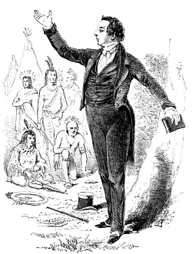
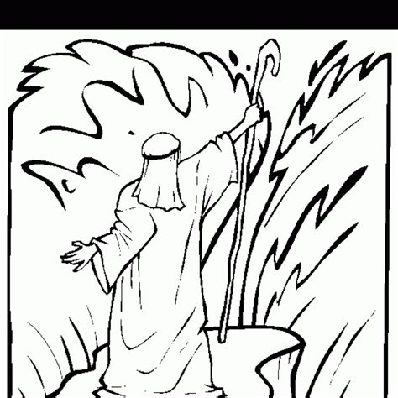
Gen 50:34 And the Lord sware unto Joseph that he would preserve his seed forever,
saying, I will raise up Moses, and a rod shall be in his hand; and he shall gather together my people, and he shall lead them as a flock; and he shall smite the waters of the Red Sea with his rod.
35 And he shall have judgment and shall write the word of the Lord.
And he shall not speak many words,
for I will write unto him my law by the finger of mine own hand. And I will make a spokesman for him,
and his name shall be called Aaron.
36 And it shall be done unto thee in the last days also, even as I have sworn. Therefore, Joseph said unto his brethren, God will surely visit you and bring you out of this land unto the land which he sware unto Abraham, and unto Isaac, and to Jacob.
37 And Joseph confirmed many other things unto his brethren and took an oath of the children of Israel, saying unto them, God will surely visit you, and ye shall carry up my bones from hence.
2Ne 2:31 Yea, thus prophesied Joseph, I am sure of this thing, even as I am sure of the promise of Moses; for the Lord hath said unto me, I will preserve thy seed forever.
32 And the Lord hath said, I will raise up a Moses, and I will give power unto him in a rod;
33 And I will give judgment unto him in writing.
34 Yet I will not loose his tongue, that he shall speak much; for I will not make him mighty in speaking.
35 But I will write unto him my law by the finger of mine own hand; and I will make a spokesman for him.
36 And the Lord said unto me also, I will raise up unto the fruit of thy loins, and I will make for him a spokesman.
2Ne 2:37 And I, behold, I will give unto him that he shall write the writing of the fruit of thy loins unto the fruit of thy loins; and the spokesman of thy loins shall declare it.
2Ne 2:38 And the words which he shall write shall be the words which are expedient in my wisdom should go forth unto the fruit of thy loins.
2Ne 2:39 And it shall be as if the fruit of thy loins had cried unto them from the dust; for I know their faith.
2Ne 2:40 And they shall cry from the dust, yea, even repentance unto their brethren, even after many generations have gone by them.
2Ne 2:41 And it shall come to pass that their cry shall go, even according to the simpleness of their words.

Slide 17
Gen 50:34 And the Lord sware unto Joseph that he would preserve his seed forever,
saying, I will raise up Moses, and a rod shall be in his hand; and he shall gather together my people, and he shall lead them as a flock; and he shall smite the waters of the Red Sea with his rod.
35 And he shall have judgment and shall write the word of the Lord.
And he shall not speak many words,
for I will write unto him my law by the finger of mine own hand. And I will make a spokesman for him,
and his name shall be called Aaron.
36 And it shall be done unto thee in the last days also, even as I have sworn. Therefore, Joseph said unto his brethren, God will surely visit you and bring you out of this land unto the land which he sware unto Abraham, and unto Isaac, and to Jacob.
37 And Joseph confirmed many other things unto his brethren and took an oath of the children of Israel, saying unto them, God will surely visit you, and ye shall carry up my bones from hence.
2Ne 2:31 Yea, thus prophesied Joseph, I am sure of this thing, even as I am sure of the promise of Moses; for the Lord hath said unto me, I will preserve thy seed forever.
32 And the Lord hath said, I will raise up a Moses, and I will give power unto him in a rod;
33 And I will give judgment unto him in writing.
34 Yet I will not loose his tongue, that he shall speak much; for I will not make him mighty in speaking.
35 But I will write unto him my law by the finger of mine own hand; and I will make a spokesman for him.
36 And the Lord said unto me also, I will raise up unto the fruit of thy loins, and I will make for him a spokesman.
2Ne 2:37 And I, behold, I will give unto him that he shall write the writing of the fruit of thy loins unto the fruit of thy loins; and the spokesman of thy loins shall declare it.
2Ne 2:38 And the words which he shall write shall be the words which are expedient in my wisdom should go forth unto the fruit of thy loins.
2Ne 2:39 And it shall be as if the fruit of thy loins had cried unto them from the dust; for I know their faith.
2Ne 2:40 And they shall cry from the dust, yea, even repentance unto their brethren, even after many generations have gone by them.
2Ne 2:41 And it shall come to pass that their cry shall go, even according to the simpleness of their words.

Slide 18

Gen 50:34 And the Lord sware unto Joseph that he would preserve his seed forever,
saying, I will raise up Moses, and a rod shall be in his hand; and he shall gather together my people, and he shall lead them as a flock; and he shall smite the waters of the Red Sea with his rod.
35 And he shall have judgment and shall write the word of the Lord.
And he shall not speak many words,
for I will write unto him my law by the finger of mine own hand. And I will make a spokesman for him,
and his name shall be called Aaron.
36 And it shall be done unto thee in the last days also, even as I have sworn. Therefore, Joseph said unto his brethren, God will surely visit you and bring you out of this land unto the land which he sware unto Abraham, and unto Isaac, and to Jacob.
37 And Joseph confirmed many other things unto his brethren and took an oath of the children of Israel, saying unto them, God will surely visit you, and ye shall carry up my bones from hence.
2Ne 2:31 Yea, thus prophesied Joseph, I am sure of this thing, even as I am sure of the promise of Moses; for the Lord hath said unto me, I will preserve thy seed forever.
32 And the Lord hath said, I will raise up a Moses, and I will give power unto him in a rod;
33 And I will give judgment unto him in writing.
34 Yet I will not loose his tongue, that he shall speak much; for I will not make him mighty in speaking.
35 But I will write unto him my law by the finger of mine own hand; and I will make a spokesman for him.
36 And the Lord said unto me also, I will raise up unto the fruit of thy loins, and I will make for him a spokesman.
2Ne 2:37 And I, behold, I will give unto him that he shall write the writing of the fruit of thy loins unto the fruit of thy loins; and the spokesman of thy loins shall declare it.
2Ne 2:38 And the words which he shall write shall be the words which are expedient in my wisdom should go forth unto the fruit of thy loins.
2Ne 2:39 And it shall be as if the fruit of thy loins had cried unto them from the dust; for I know their faith.
2Ne 2:40 And they shall cry from the dust, yea, even repentance unto their brethren, even after many generations have gone by them.
2Ne 2:41 And it shall come to pass that their cry shall go, even according to the simpleness of their words.
D&C 27

Slide 19
Section 27
  August or September, 1830-Fayette, New York. Revelation received for Oliver Cowdery concerning his brother-in-law Hiram Page. Hiram had presented purported revelations through use of a "peep stone." This was causing dissension among members of the church, including Cowdery and the Whitmer family. Oliver was given responsibility to settle the situation.
D&C 27:1 Behold, I say unto thee, Oliver, that it shall be given unto thee that thou shalt be heard by the church in all things whatsoever thou shalt teach them by the Comforter concerning the revelations and commandments which I have given.
D&C 27:2a But behold, verily, verily, I say unto thee, No one shall be appointed to receive commandments and revelations in this church excepting my servant Joseph Smith, Jr., for he receiveth them, even as Moses;
D&C 27:2b and thou [Oliver] shalt be obedient unto the things which I shall give unto him, even as Aaron, to declare faithfully the commandments and revelations with power and authority unto the church.
D&C 27:2c And if thou art led at any time by the Comforter to speak or teach, or at all times by the way of commandment unto the church, thou mayest do it.
D&C 27:2d But thou shalt not write by way of commandment, but by wisdom; and thou shalt not command him who is at thy head and at the head of the church, for I have given him the keys of the mysteries and the revelations, which are sealed, until I shall appoint unto them another in his stead.

Slide 20
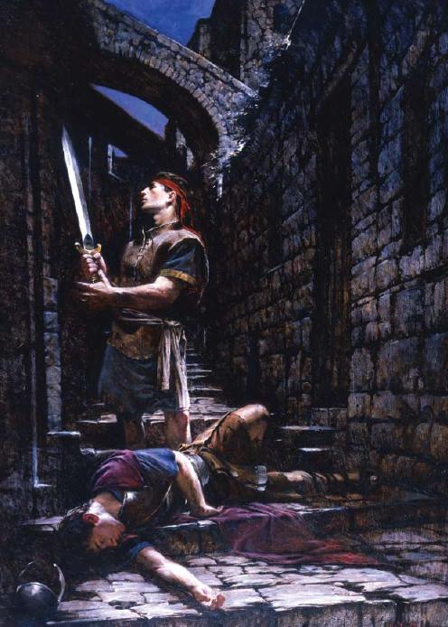
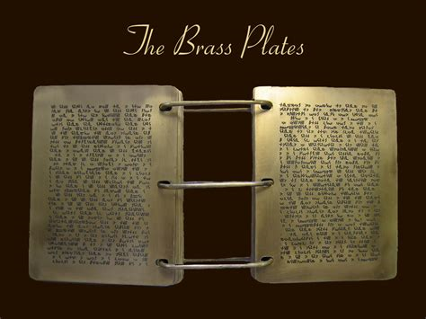
2Ne 2:42 Because of their faith, their words shall proceed forth out of my mouth unto their brethren, who are the fruit of thy loins;
2Ne 2:43 And the weakness of their words will I make strong in their faith, unto the remembering of my covenant which I made unto thy fathers.
2Ne 2:44 And now, behold, my son Joseph, after this manner did my father of old prophesy.
2Ne 2:45 Wherefore, because of this covenant thou art blessed, for thy seed shall not be destroyed, for they shall hearken unto the words of the book.
2Ne 2:46 And there shall rise up one mighty among them, who shall do much good, both in word and in deed, being an instrument in the hands of God, with exceeding faith,
2Ne 2:47 To work mighty wonders and do that thing which is great in the sight of God, unto the bringing to pass much restoration unto the house of Israel and unto the seed of thy brethren.
2Ne 2:48 And now, blessed art thou, Joseph.
2Ne 2:49 Behold, thou art little; wherefore, hearken unto the words of thy brother Nephi, and it shall be done unto thee, even according to the words which I have spoken.
2Ne 2:50 Remember the words of thy dying father. Amen.
2Ne 3:1 And now, I, Nephi, speak concerning the prophecies of which my father hath spoken concerning Joseph, who was carried into Egypt:
2Ne 3:2 For behold, he truly prophesied concerning all his seed.
2Ne 3:3 And the prophecies which he wrote, there are not many greater.
2Ne 3:4 And he prophesied concerning us and our future generations;
2Ne 3:5 And they are written upon the plates of brass.

Slide 21
Why God commanded Lehi to get Plates of Brass
Mosiah 1:4 And he also taught them concerning the records which were engraven on the plates of brass, saying, My sons, I would that ye should remember that were it not for these plates, which contain these records and these commandments, we must have suffered in ignorance, even at this present time, not knowing the mysteries of God;
Mos 1:5 For it were not possible that our father Lehi could have remembered all these things, to have taught them to his children, except it were for the help of these plates;
Mos 1:6 For he, having been taught in the language of the Egyptians, therefore, he could read these engravings and teach them to his children, that thereby they could teach them to their children, and so fulfilling the commandments of God, even down to this present time.

Slide 22
Why God commanded Lehi to get Plates of Brass
Mosiah 1:4 And he also taught them concerning the records which were engraven on the plates of brass, saying, My sons, I would that ye should remember that were it not for these plates, which contain these records and these commandments, we must have suffered in ignorance, even at this present time, not knowing the mysteries of God;
Mos 1:5 For it were not possible that our father Lehi could have remembered all these things, to have taught them to his children, except it were for the help of these plates;
Mos 1:6 For he [LEHI], having been taught in the language of the Egyptians, therefore, he could read these engravings and teach them to his children, that thereby they could teach them to their children, and so fulfilling the commandments of God, even down to this present time.

Slide 23
1Ne 3:157 And I beheld a book, and it was carried forth among them.
1Ne 3:158 And the angel said unto me, Knowest thou the meaning of the book?
1Ne 3:159 And I said unto him, I know not.
1Ne 3:160 And he said, Behold, it proceedeth out of the mouth of a Jew; and I, Nephi, beheld it.
1Ne 3:161 And he said unto me, The book that thou beholdest is a record of the Jews, which contains the covenants of the Lord which he hath made unto the house of Israel;
1Ne 3:162 And it [the Bible] also containeth many of the prophecies of the holy prophets;
1Ne 3:163 And it is a record like unto the engravings which are upon the plates of brass, save there are not so many; nevertheless, they contain the covenants of the Lord which he hath made unto the house of Israel;
1Ne 3:164 Wherefore, they are of great worth unto the Gentiles.
1Ne 3:165 And the angel of the Lord said unto me, Thou hast beheld that the book proceeded forth from the mouth of a Jew; and when it proceeded forth from the mouth of a Jew, it contained the plainness of the gospel of the Lord, of whom the twelve apostles bear record; and they bear record according to the truth which is in the Lamb of God.
1Ne 3:166 Wherefore, these things go forth from the Jews in purity unto the Gentiles, according to the truth which is in God.
1Ne 3:167 And after they go forth by the hand of the twelve apostles of the Lamb, from the Jews unto the Gentiles, thou seest the foundation of a great and abominable church, which is most abominable above all other churches;
1Ne 3:168 For behold, they have taken away from the gospel of the Lamb many parts which are plain and most precious;
1Ne 3:169 And also many covenants of the Lord have they taken away;
1Ne 3:170 And all this have they done that they might pervert the right ways of the Lord, that they might blind the eyes and harden the hearts of the children of men.
1Ne 3:171 Wherefore, thou seest that after the book hath gone forth through the hands of the great and abominable church, that there are many plain and precious things taken away from the book, which is the book of the Lamb of God;
1Ne 3:172 And after these plain and precious things were taken away, it goeth forth unto all the nations of the Gentiles;
1Ne 3:173 And after it goeth forth unto all the nations of the Gentiles, yea, even across the many waters which thou hast seen, with the Gentiles which have gone forth out of captivity,
1Ne 3:174 Thou seest because of the many plain and precious things which have been taken out of the book, which were plain unto the understanding of the children of men, according to the plainness which is in the Lamb of God,
1Ne 3:175 Because of these things which are taken away out of the gospel of the Lamb, an exceeding great many do stumble, yea, insomuch that Satan hath great power over them.

Slide 24
1Ne 1:159 And he beheld that they [the brass plates] did contain the five books of Moses, which gave an account of the creation of the world,
1Ne 1:160 And also of Adam and Eve, who were our first parents,
1Ne 1:161 And also a record of the Jews from the beginning, even down to the commencement of the reign of Zedekiah, king of Judah,
1Ne 1:162 And also the prophecies of the holy prophets, from the beginning, even down to the commencement of the reign of Zedekiah,
1Ne 1:163 And also many prophecies which have been spoken by the mouth of Jeremiah.
1Ne 1:164 And it came to pass that my father Lehi also found upon the plates of brass a genealogy of his fathers;
1Ne 1:165 Wherefore, he knew that he was a descendant of Joseph, [Alma 8:3 And Aminadi was a descendant of Nephi, who was the son of Lehi, who came out of the land of Jerusalem, who was a descendant of Manasseh, who was the son of Joseph, who was sold into Egypt by the hands of his brethren.] yea, even that Joseph who was the son of Jacob, who was sold into Egypt and who was preserved by the hand of the Lord, that he might preserve his father Jacob and all his household from perishing with famine. (Gen 50:20)
1Ne 1:166 And they were also led out of captivity and out of the land of Egypt by that same God who had preserved them.
1Ne 1:167 And thus my father Lehi did discover the genealogy of his fathers.
1Ne 1:168 And Laban also was a descendant of Joseph; wherefore, he and his fathers had kept the records.
1Ne 1:169 And now, when my father saw all these things, he was filled with the Spirit and began to prophesy concerning his seed--that these plates of brass should go forth unto all nations, kindreds, tongues, and people who were of his seed.
1Ne 1:170 Wherefore, he said that these plates of brass should never perish, neither should they be dimmed any more by time.

Slide 25



